Slide 1

Trust Agent Framework for AI
TAFFAI
Thomas McCarthy-Howe
CTO
Strolid
thomas.howe@strolid.com
Steve Lasker
Director of Ecosystem
DataTrails
Steve.Lasker@DataTrails.ai
@SteveLasker

Slide 2

AI: Learning from Information to Make Informed Decisions

Slide 3

What Is the Source of the Information?

Slide 4

What Was the Intent of the Information

Slide 5
Can We Trust What Happens to the Data When “Stuff Happens”

Slide 6



The Justice Department found Boeing violated a 2021 agreement that shielded it from prosecution over the crashes
"diesel dupe". The EPA found VW cars being sold in America had a "defeat device"
Rite Aid Banned from Using AI Facial Recognition After FTC Says Retailer Deployed Technology without Reasonable Safeguards

Slide 7

TA Trust: Agent trusted to hold verifiable proof, at a point in time
F ramework: a standard set of building blocks and processes
F or
AI: operations performed based on the learning of information fed

Slide 8
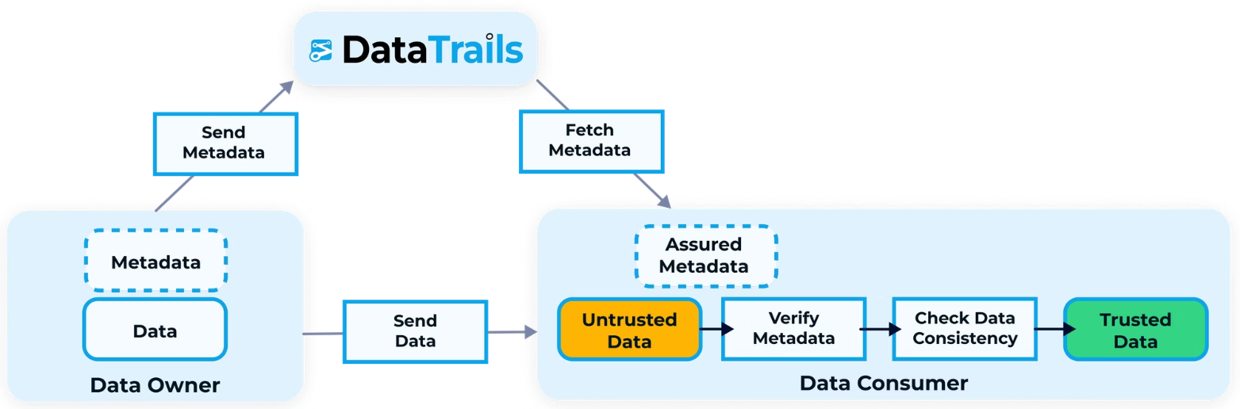
SCITT

Slide 9
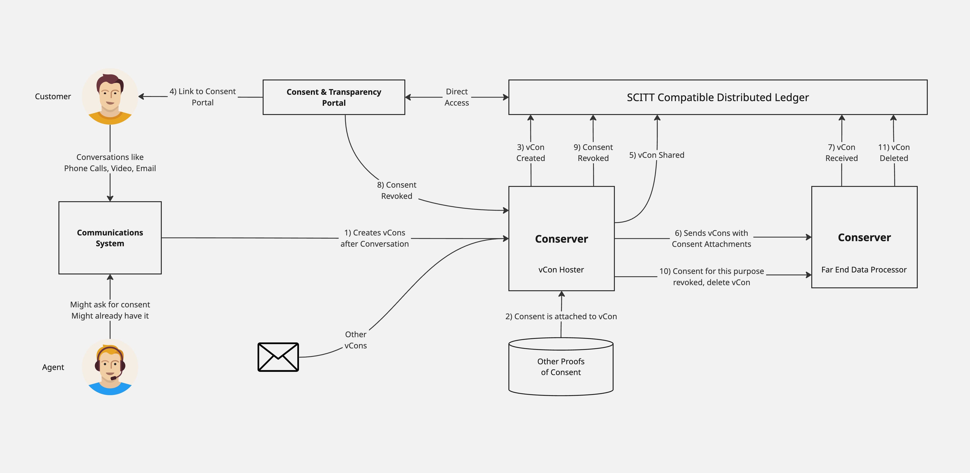

Slide 10
TAFFAI
Provides independent verification of information
A 3rd party, trusted amongst the parties
Steve Lasker Director of Ecosystem DataTrails Steve.Lasker@DataTrails.ai @SteveLasker
Thomas McCarthy-Howe CTO Strolid thomas.howe@strolid.com

Slide 11
DataTrails Provides
Immutable, Append-Only, Distributed Ledger
Evidentiary Storage
Ability to delete (forget) the metadata
Ability to redact – limiting who has access to the “metadata”
Indexing and Query Services
Role Based Access Control
Redaction and other constraints on access
Steve Lasker Director of Ecosystem DataTrails Steve.Lasker@DataTrails.ai @SteveLasker

Slide 12


Notes:
Create a featured image depicting a futuristic Trust Agents for AI, symbolizing a digital guardian or sentient being overseeing AI interactions. In the background, Incorporate lots of elements such as a holographic displays of digital information and documents from internet sources that suggest security and reliability. Use soft, ethereal lighting with a blue and green color palette to evoke a sense of trust and technology. The background should be a sleek, modern digital landscape. Ensure the image is high resolution, richly detailed, and in sharp focus, subtly showcasing advanced AI elements around it. Put the torso and head of the sentient being in the middle of all the holographic information being displayed. Make the face of the sentient being trustworthy with a subtle smile. Do not put any text or logos on the sentient being.

